Slide 1
Pattern of Lossess
Static visualization from Tableau Software

Slide 2
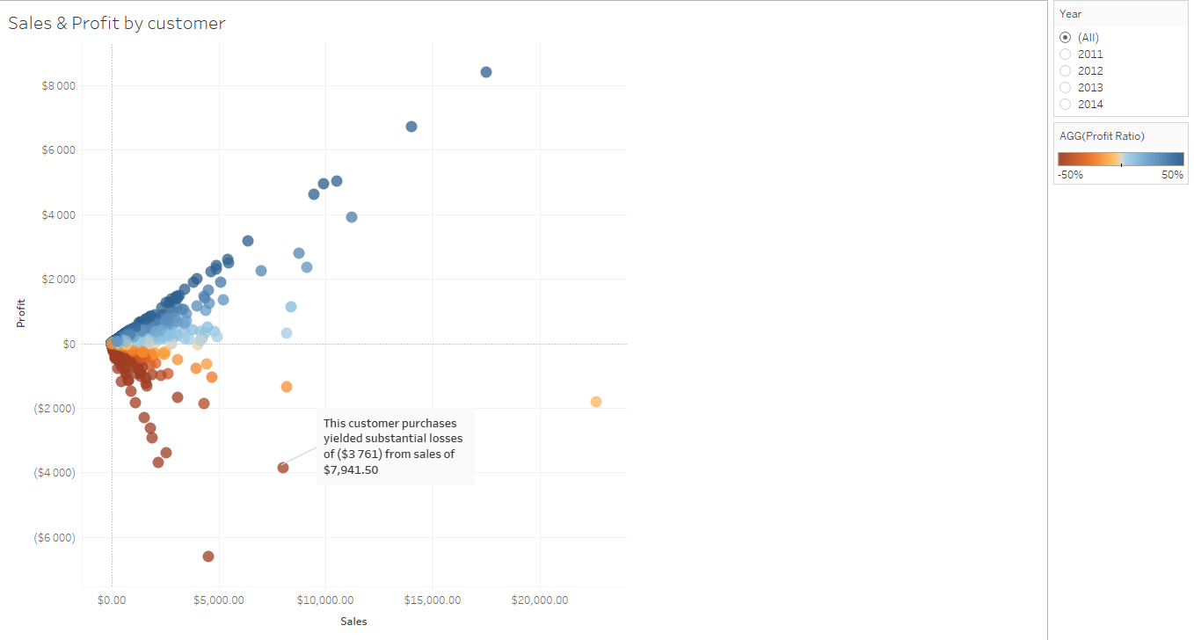
What is the situation ?
Most of our customers made us earn money but some of them made us running a lot of lossess

Slide 3
What can be the cause ?
We’ve got 3 possibilities :
Geography
Type of products
Proposed prices - Discounts

Slide 4

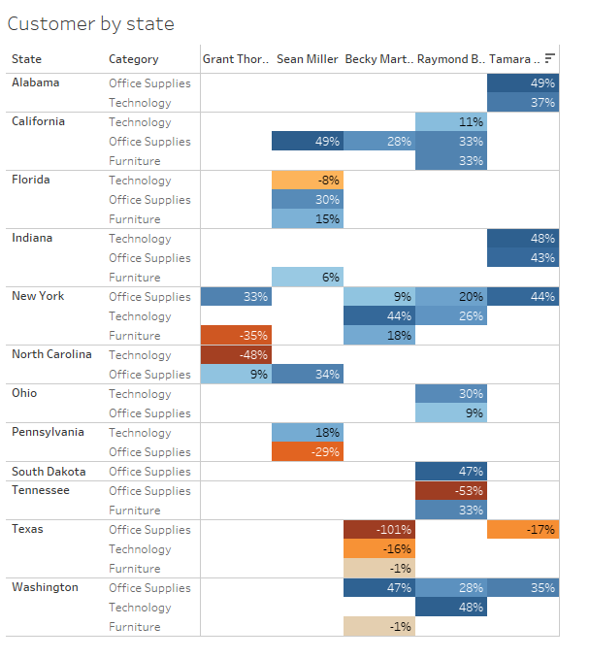
Geography has not impact of profit
Notes:
Texas is an outlier but does not show any pattern

Slide 5

Yes, it’s a type of Product but it is not the category.
It seems that even if a category does not show any pattern, when we look at a sub category level, some sub categories seems to be profitable whereas other made us running some losses

Slide 6
The impact of level of Discount
Percentage of discount vs Profit ratio :
Percentage of discount impact highly the profit :
Discount are highly applied on some products and less on other, this impact directly the profit of o

Slide 7
Conclusion & Recommandations
Geography may have outliers but it doesn’t seem to have a patttern. I do not recommand to look at geography to improve our profits in first round
The type of products may be an issue as inside a category, products do not bring same level of profit
Some customers seems to receive important amount of discount and this issue brings some losses to our company. Discount policy has to be review

